Slide 1


Aircraft risk assessment to guide aviation market entry

Slide 2
Project Overview
Exploring aviation risks to guide aircraft investment
Goal: Identify low-risk aircraft types for commercial and private operations
Stakeholder: Head of Aviation Division
Timeframe: Accidents from 1962 – 2023

Slide 3
Business Understanding
Why This Matters
Our company is entering the aviation industry
Risk exposure directly impacts safety , liability and cost
We need data to identify the safest aircraft types

Slide 4
DATA OVERVIEW
The NTSB Aviation Accident Dataset
Source: National Transportation Safety Board
Timeframe: 1962 – 2023
Scope: Civil aviation accidents and incidents
Key features: Aircraft type, engine type, phase of flight, fatalities, location and weather.

Slide 5
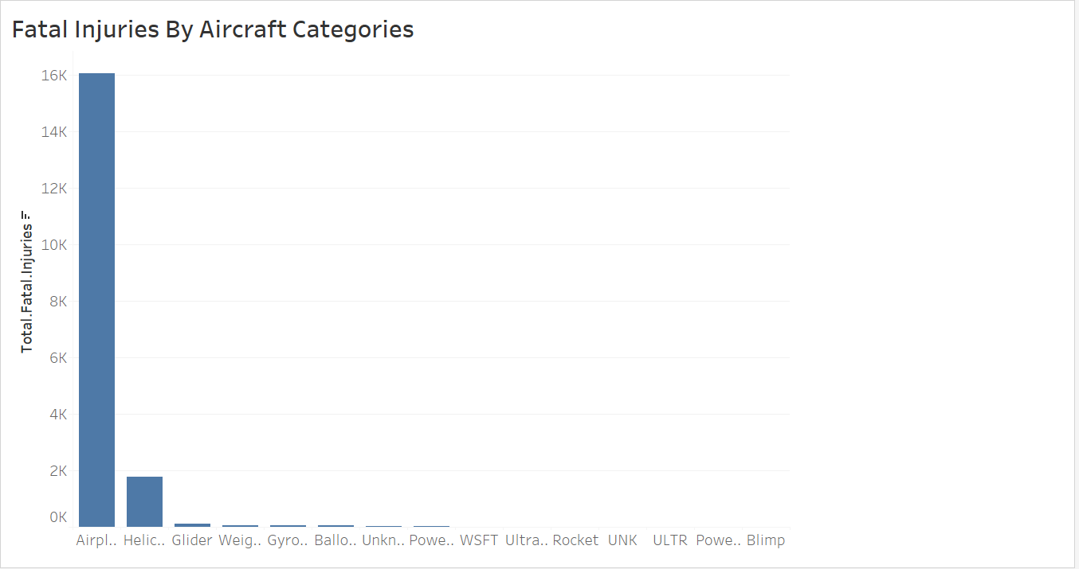
Accident rates by Aircraft Category
Bar chart showing accident frequency per aircraft type
Insight: Multi-engine and helicopters show higher incident rates
Recommendation: Start with single-engine fixed-wing aircraft for lower risk.

Slide 6
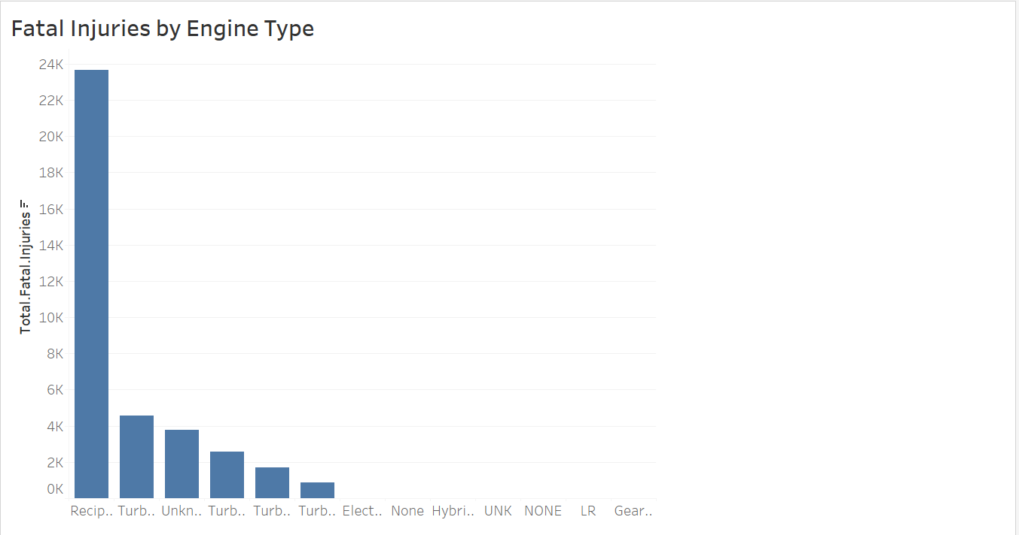
Fatalities by Engine Type
Bar chart comparing fatality rates by engine type
Insight: Turboprop aircraft had lower fatality-to-accident ratio
Recommendation: Prioritize turboprop engines for initial investments.

Slide 7
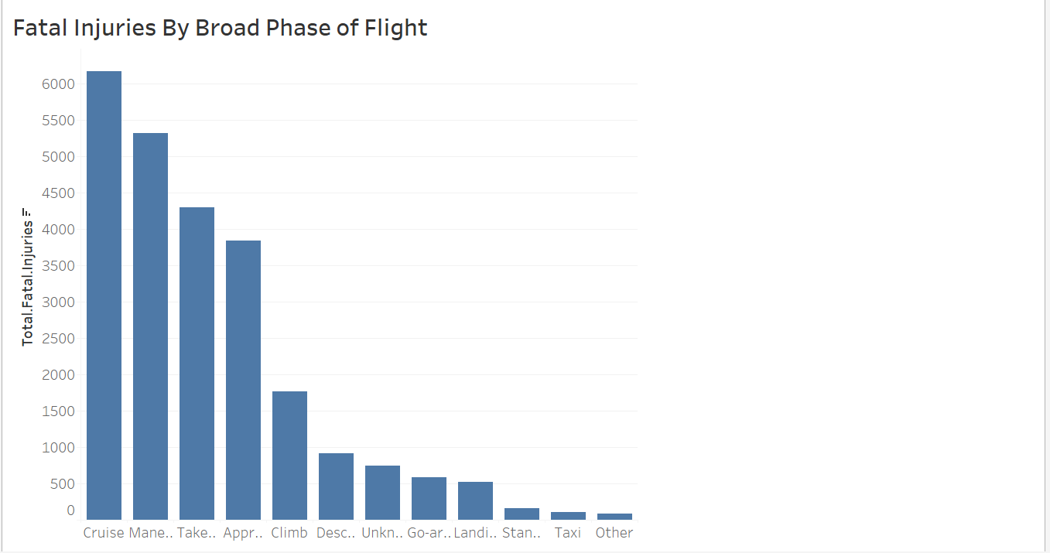
Fatal Injuries by Broad Phase of Flight
Bar chart comparing fatality rates at different phases of flight.
Recommendation: Focus should be on minimizing risks during takeoffs and landing by ensuring additional training for pilots especially in adverse conditions e.g., weather.
Insights: Takeoff and landing phases tend to result more in severe injuries.

Slide 8
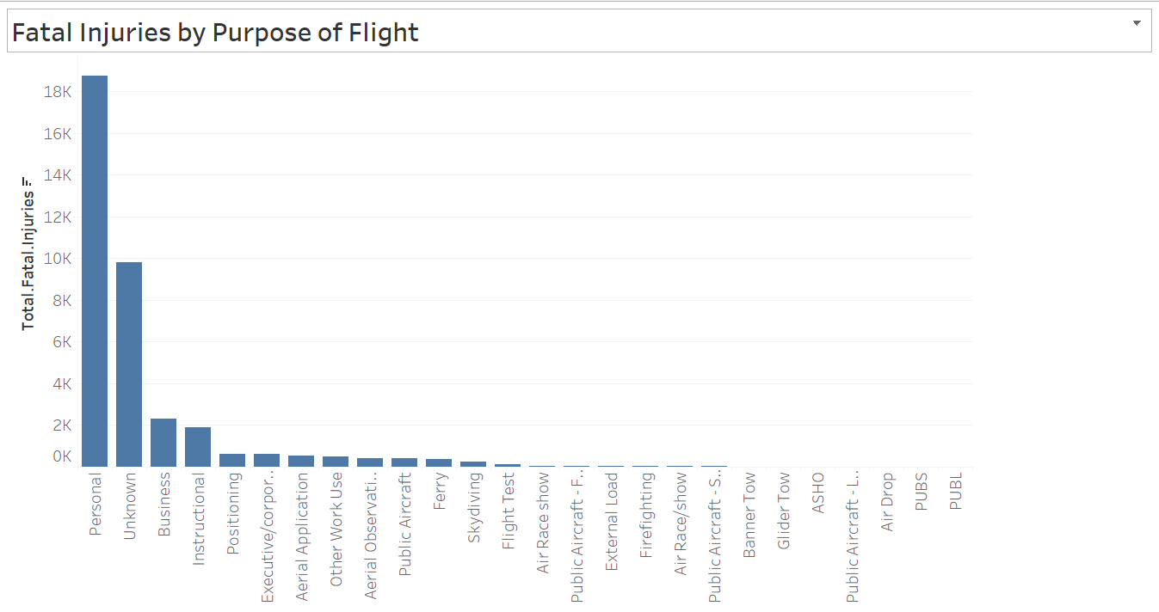
Incident severity by flight purpose
Bar chart comparing fatality rates by flight purpose; commercial and personal flights.
Recommendation: For commercial flights, focus should be on reducing risks during high-risk phases through better training, technology and operational procedures. In addition, passenger safety programs should be enhanced.
Insights: Commercial flights tend to experience higher severity levels while personal flights may involve fewer severe injuries.

Slide 9
General Recommendations
Data-Driven Safety Measures: Use insights from incident trends, aircraft makes and flight phases to develop targeted safety strategies.
Preventive Maintenance: Focus on aircraft maintenance especially for makes and models with higher incident rates reducing mechanical failures.
Regulatory compliance: Implement proactive measures to ensure compliance and even exceed minimum safety requirements.
Pilot and crew training: Invest in regular and advanced training programs for pilots particularly for high-risk flight phrases like takeoff and landing.
Technological Investments: Incorporating advanced technologies such as automatic response systems, enhanced navigation systems and real time data analytics to reduce human error and improve response times.

Slide 10
THE END
Benson Mwihia
bensonmwihia@gmail.com
LinkedIn:https://www.linkedin.com/in/benson-mwihia-3191ab76/

